Slide 1

DAY01
Chapters 1 - 3

Slide 2
Special Characters
Character
//
#
Name
Double slash
Pound sign
Meaning
Beginning of a comment
Beginning of preprocessor directive
Enclose filename in #include
Used when naming a function
< >
( )
Open/close brackets
Open/close parentheses
Open/close brace
{ }
Encloses a group of statements
" "
Open/close quotation marks
Semicolon
Encloses string of characters
;
End of a programming statement

Slide 3
The Parts of a C++ Program
// sample C++ program #include <iostream> using namespace std; int main()
{
cout << "Hello, there!"; return 0;
}

Slide 4
The cout Object
Can be used to send more than one item to cout:
cout << "Hello " << "there!";
Or:
cout | << | "Hello ";
cout | << | "there!";

Slide 5
The endl Manipulator
You can use the endl manipulator to start a new line of output. This will produce two lines of output:
cout << "Programming is" << cout << "fun!";
endl;
You can also use the \n escape sequence to start a new line of output. This will produce two lines of output:
Programming is fun!
cout << "Programming is\n";
cout << "fun!";

Slide 6
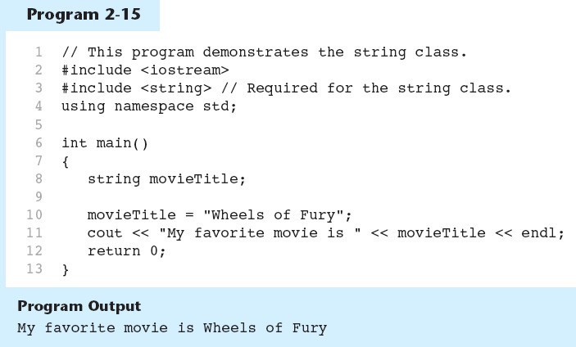
The string class in Program 2-15

Slide 7
Single-Line Comments
Multi-Line Comments
Begin with // through to the end of line:
int length = 12; // length in inches
Begin with /*, end with */
Can span multiple lines:
/* this is a multi-line
comment
*/
Can begin and end on the same line:
int area; /* calculated area *
int width = 15; int area;
// width in inches
// calculated area
// calculate rectangle area area = length * width;

Slide 8
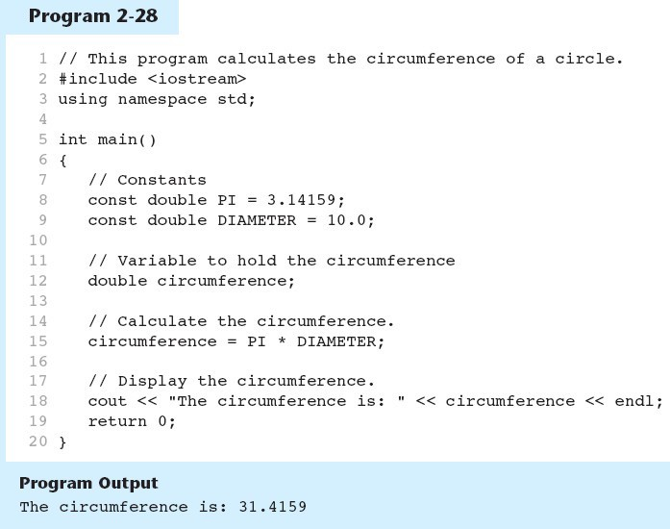
Named Constants in Program 2-28

Slide 9
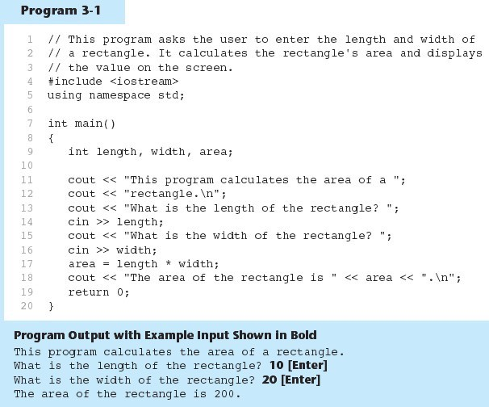
The cin Object in Program 3-1

Slide 10
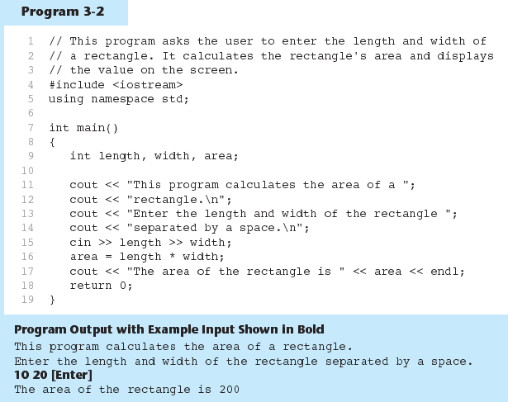
The cin Object Gathers Multiple Values in Program 3-2

Slide 11
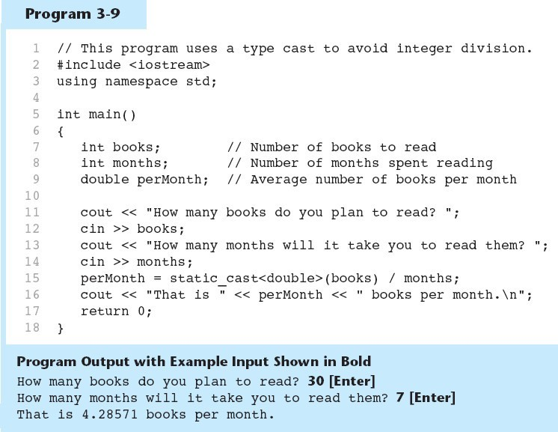
Type Casting in Program 3-9
A type cast expression lets you manually promote or demote a value. The general format of a type cast expression is
static_cast< DataType >( Value )

Slide 12
Multiple Assignment and Combined Assignment
The = can be used to assign a value to multiple variables:
x = y = z = 5;
Value of = is the value that is assigned
Associates right to left:
x = (y = (z = 5));
value is 5
value is 5
value is 5
sum = sum + 1;
This adds 1 to the variable sum.

Slide 13
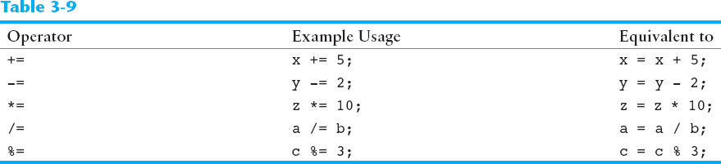
Combined Assignment Operators

Slide 14
Stream Manipulators
Some affect values until changed again:
fixed: use decimal notation for floating-point values
setprecision(x): when used with fixed, print floating-point value using x digits after the decimal. Without
fixed, print floating-point value using x significant digits
showpoint: always print decimal for floating-point values

Slide 15
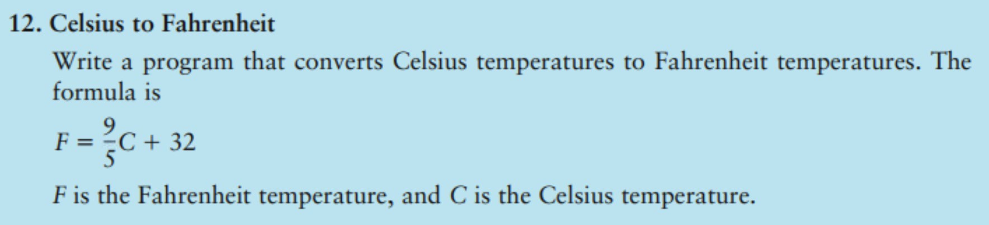

Slide 16
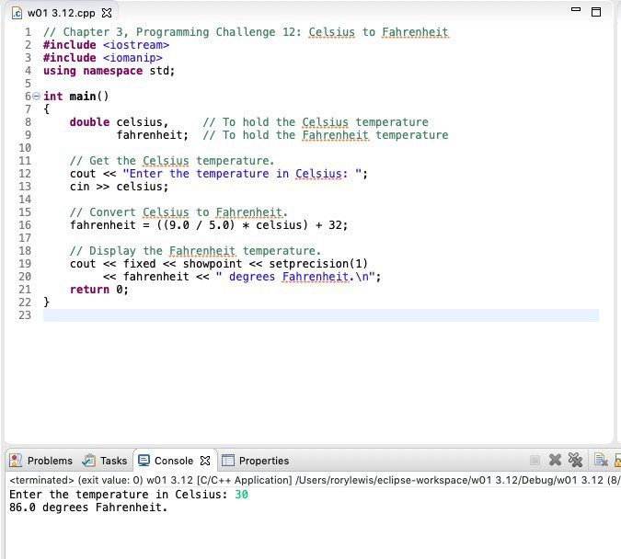

Slide 17
Decisions
Chapter 4

Slide 18

Preprocessor Directives (2 of 2)
Syntax to include a header file
For example:
#include <iostream>
Preprocessor commands are processed before the program goes through the compiler

Slide 19
namespace and Using cin and cout in a Program
To use cin and cout in a program, use the following two statements:
#include <iostream> using namespace std;

Slide 20
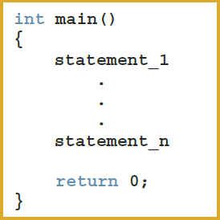
Creating a C++ Program

Slide 21
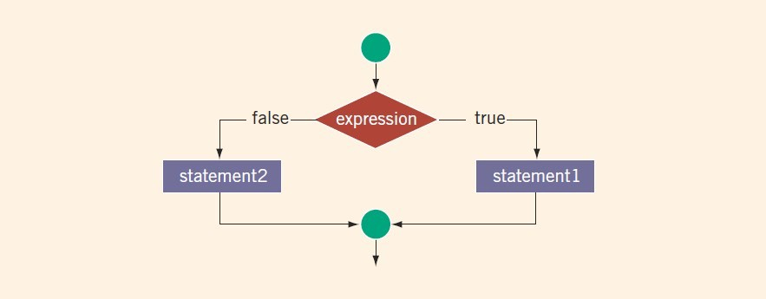
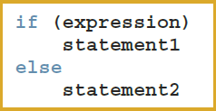
Two-Way Selection (1 of 2)
Two-way selection syntax
If expression is true, statement1 is executed; otherwise,
statement2 is executed
statement1 and statement2 are any C++ statements

Slide 22
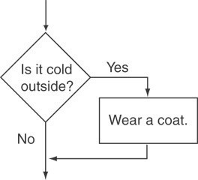
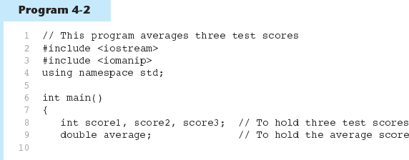
To evaluate:
Flowchart for Evaluating a Decision
if (expression)
statement;
If the expression is true, then statement is executed.
If the expression is false, then statement is skipped.

Slide 23
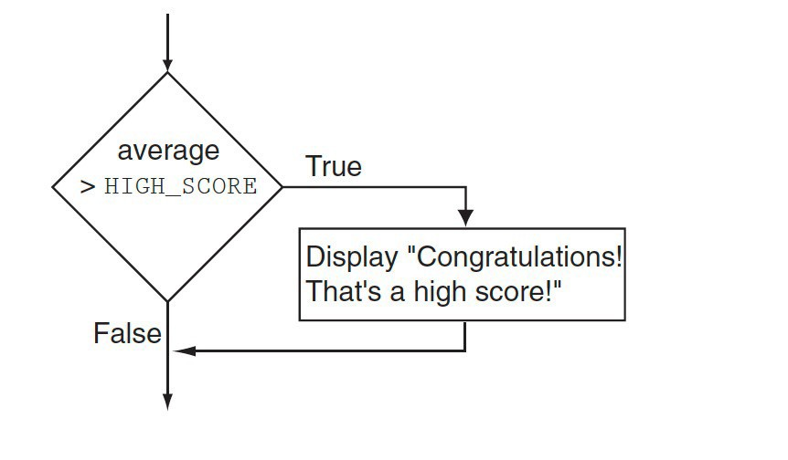
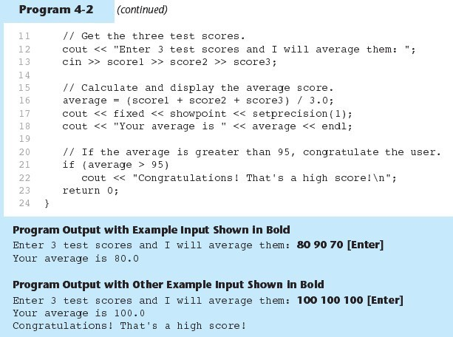
if Statement in Program 4-2

Slide 24
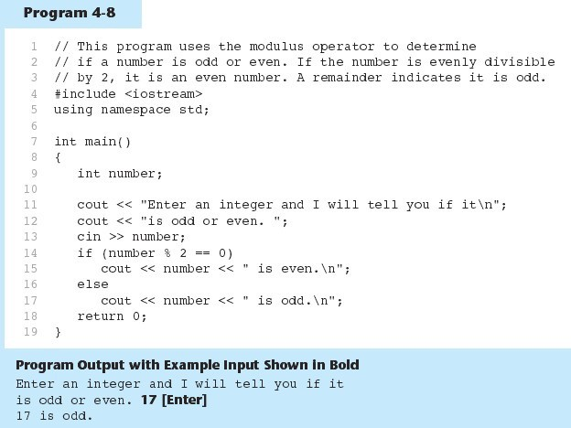
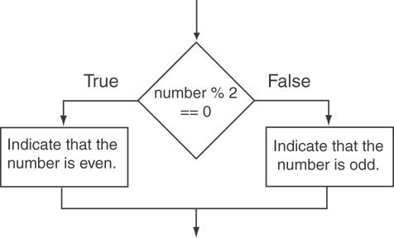
The if/else statement and Modulus Operator in Program 4-8

Slide 25
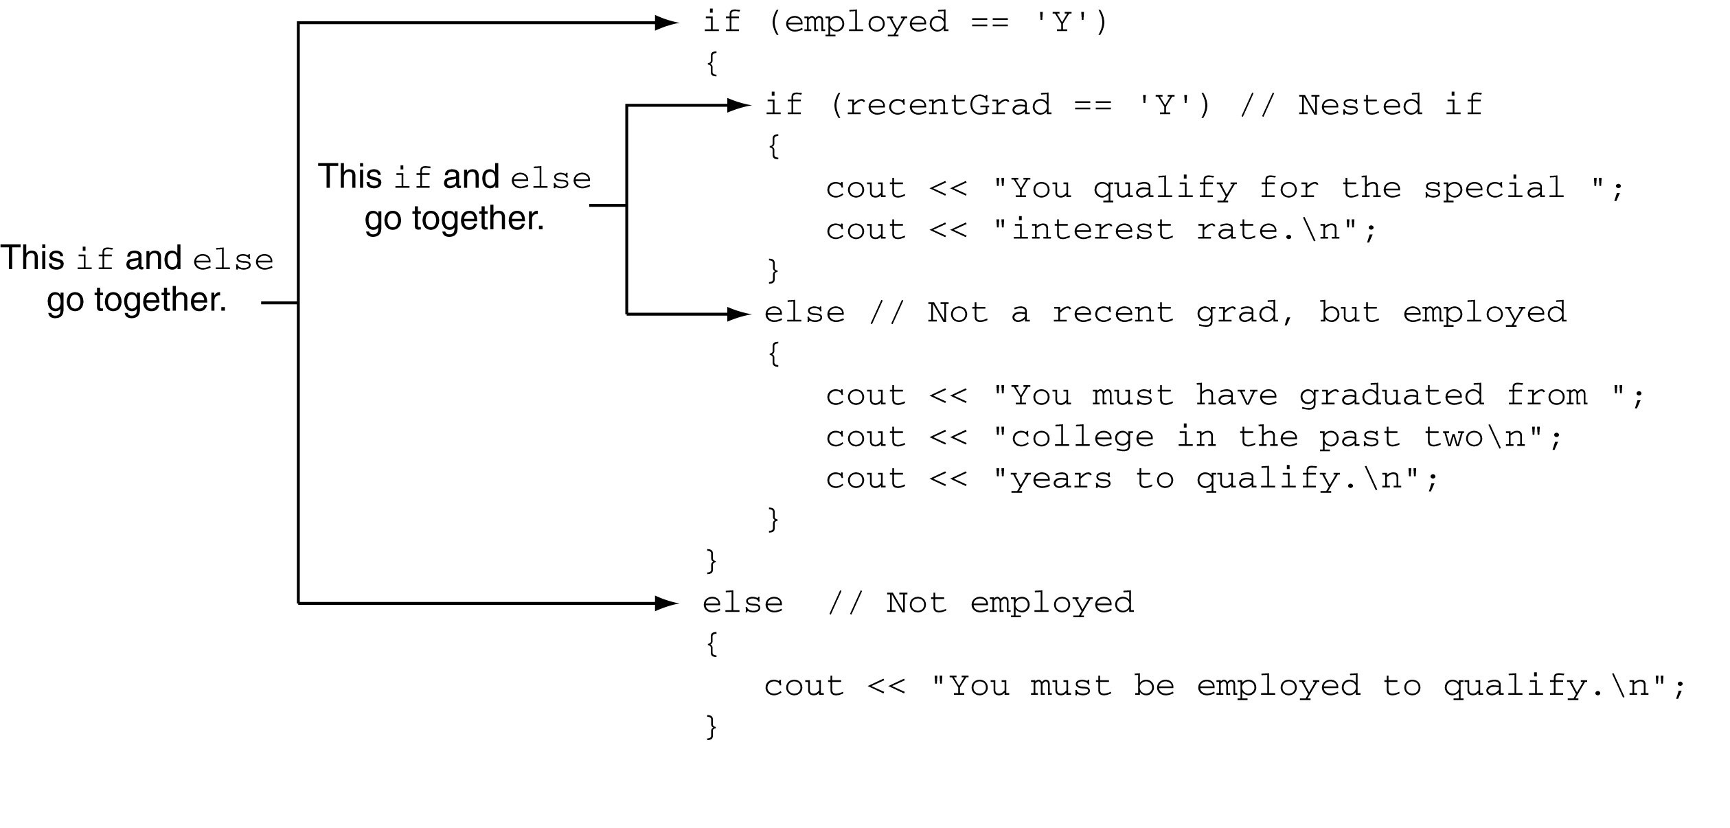
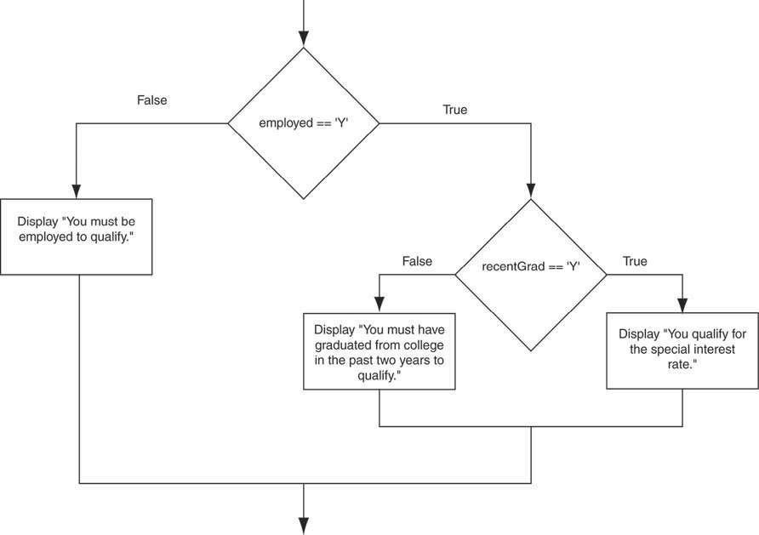
Nested if Statement

Slide 26
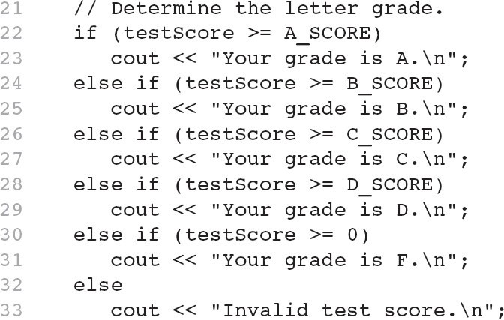
Using a Trailing else to Catch Errors in Program 4-14
The trailing else clause is optional, but it is best used to catch errors.
This trailing else catches invalid test scores

Slide 27
Logical Operators
Used to create relational expressions from other relational expressions
Operators, meaning, and explanation:
&& | AND | New relational expression is true if both expressions are true
|| | OR | New relational expression is true if either expression is true
! | NOT | Reverses the value of an expression – true expression becomes false, and false becomes true

Slide 28
Checking Numeric Ranges with Logical Operators
&& | AND | New relational expression is true if both expressions are true
|| | OR | New relational expression is true if either expression is true
! | NOT | Reverses the value of an expression – true expression becomes false, and false becomes true
Used to test to see if a value falls inside a range:
if (grade >= 0 && grade <= 100)
cout << "Valid grade";
Can also test to see if value falls outside of range:
if (grade <= 0 || grade >= 100) cout << "Invalid grade";
Cannot use mathematical notation:
if (0 <= grade <= 100) //doesn’t work!

Slide 29
The Conditional Operator
Can use to create short if/else statements
Format: expr ? expr : expr;
x<0 ? y=10 : z=20;
First Expression: Expression to be tested
2nd Expression: Executes if first expression is true
3rd Expression: Executes if the first expression is false

Slide 30
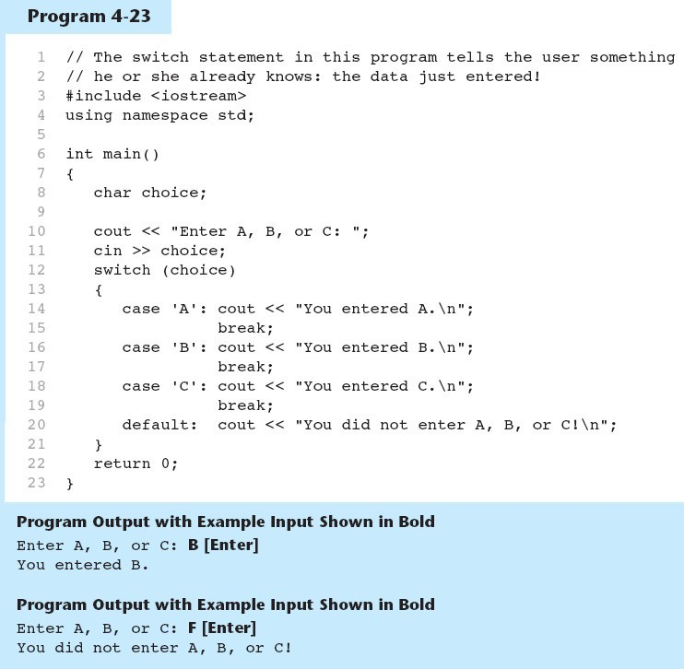
The switch Statement in Program 4-23
switch (expression) //integer
{
case | exp1: | statement1;
case | exp2: | statement2;
...
case | expn: | statementn;
default:
statementn+1;
}

Slide 31
Loops and Files
Chapter 5

Slide 32
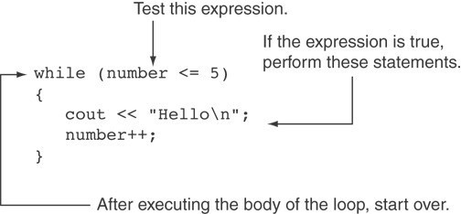
How the while Loop in Program 5-3 Lines 9 through 13 Works

Slide 33
Input Validation Example
cout << "Enter a number less than 10: "; cin >> number;
while (number >= 10)
{
cout << "Invalid Entry!"
<< "Enter a number less than 10: "; cin >> number;
}

Slide 34
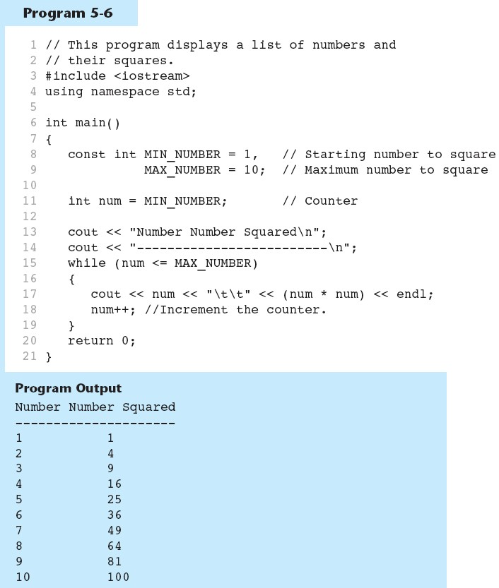
A Counter Variable Controls the Loop in Program 5-6
Continued…

Slide 35
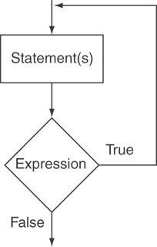
An Example do-while Loop
int x = 1; do
{
cout << x << endl;
} while(x < 0);

Slide 36
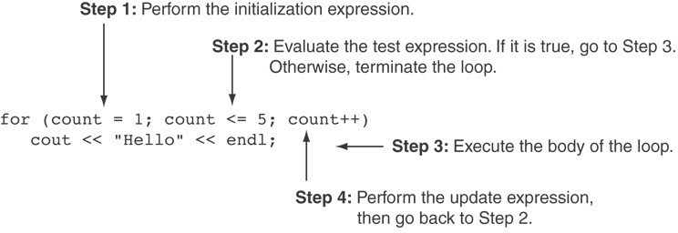
FORLOOP

Slide 37
Chapter 6
Modular Programming

Slide 38
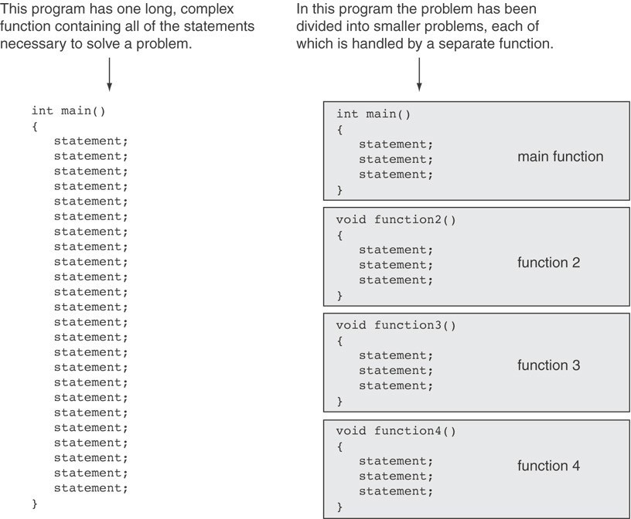

Slide 39
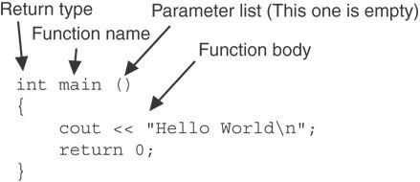
Function Definition
Note: The line that reads int main()is the
function header.

Slide 40
Function Return Type
If a function returns a value, the type of the value must be indicated:
int main()
If a function does not return a value, its return type is void:
void printHeading()
{
cout << "Monthly Sales\n";
}

Slide 41
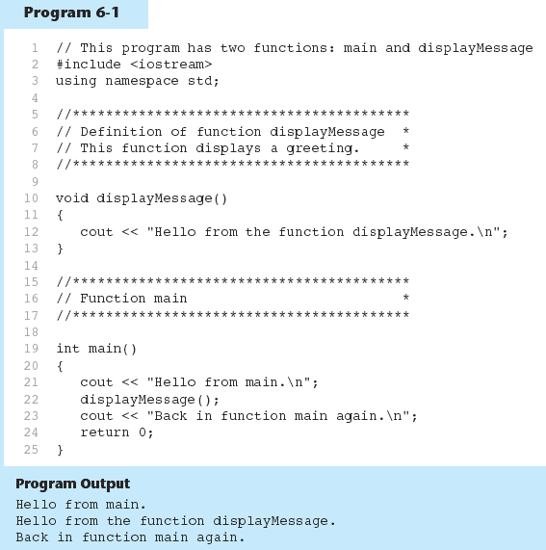

Slide 42
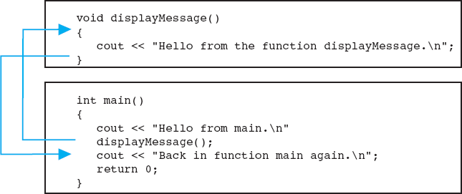
Flow of Control in Program 6-1

Slide 43
Function Prototypes
Ways to notify the compiler about a function before a call to the function:
Place function definition before calling function’s definition
Use a function prototype (function declaration) – like the function definition without the body
Header: void printHeading()
Prototype: void printHeading();

Slide 44
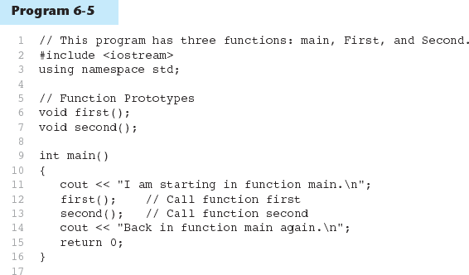
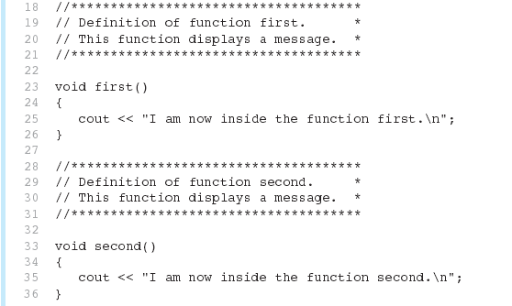
Function Prototypes in Program 6-5
(Program Continues)

Slide 45
Sending Data into a Function
Can pass values into a function at time of call:
c = pow(a, b);
Values passed to function are arguments
Variables in a function that hold the values passed as arguments are parameters

Slide 46
A Function with a Parameter Variable
void displayValue(int num)
{
cout << "The value is " << num << endl;
}

Slide 47
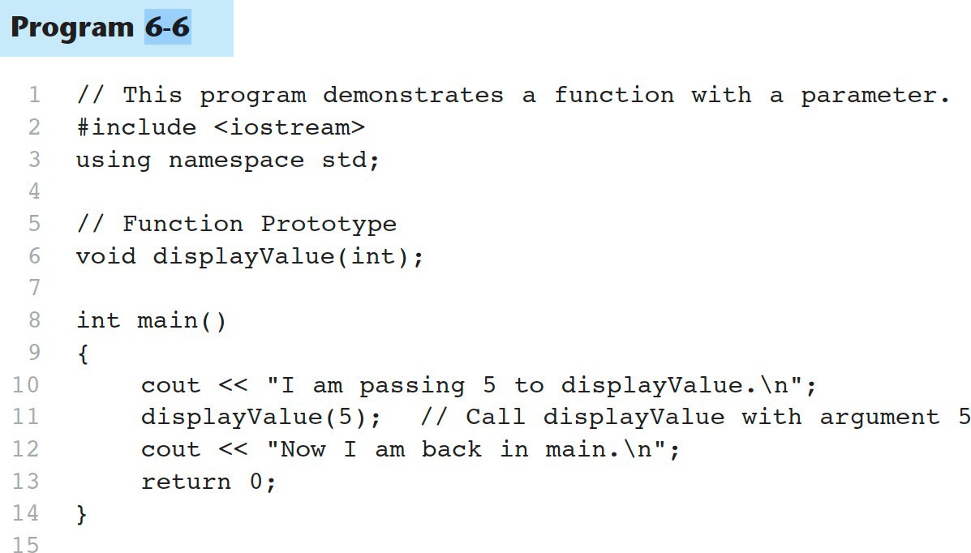
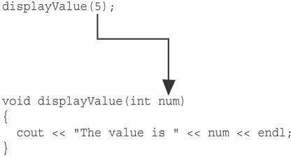
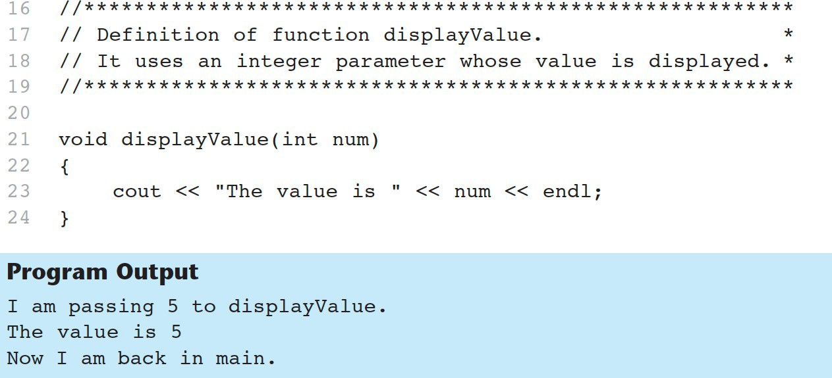
Function with a Parameter in Program 6-6

Slide 48
Parameters, Prototypes, and Function Headers
For each function argument,
the prototype must include the data type of each parameter inside its parentheses
the header must include a declaration for each parameter in its ()
void evenOrOdd(int); //prototype
void evenOrOdd(int num) //header
evenOrOdd(val); //call

Slide 49
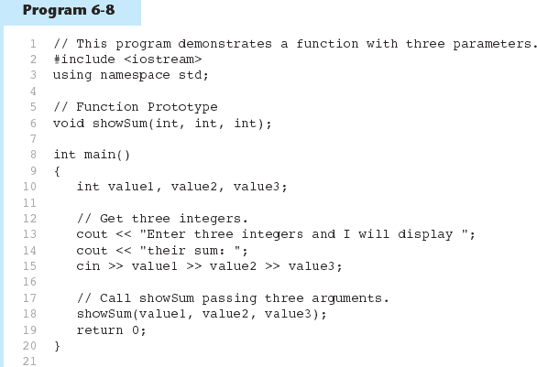
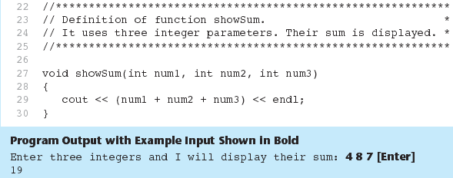
Passing Multiple Arguments in Program 6-8

Slide 50
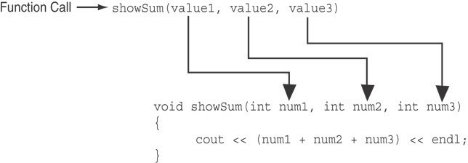
Passing Multiple Arguments in Program 6-8

Slide 51
Passing Information to Parameters by Value
Example: int
val=5;
evenOrOdd(val);
val
num
5
5
argument in
parameter in
evenOrOdd function
calling function
evenOrOdd can change variable num, but it will have no effect on variable val

Slide 52
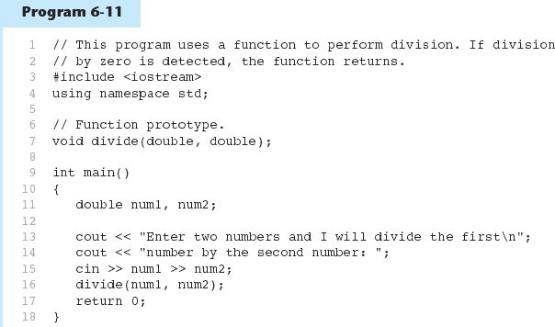
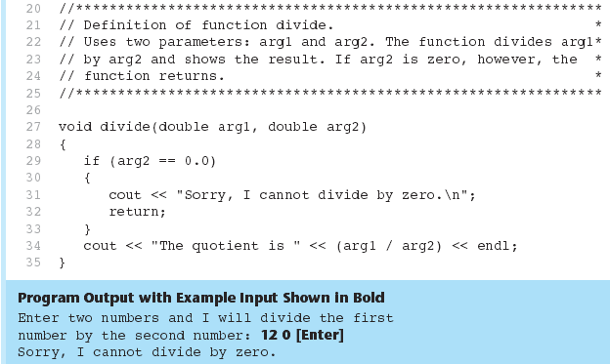
Performing Division in Program 6-11
(Program Continues)

Slide 53
Returning a Value From a Function
In a value-returning function, the return statement can be used to return a value from function to the point of call. Example:
int sum(int num1, int num2)
{
double | result;
result | = num1 + | num2;
return | result;
}

Slide 54
A Value-Returning Function
Return Type
int sum(int num1, int num2)
{
double result;
result = num1 + num2; return result;
}
Value Being Returned

Slide 55
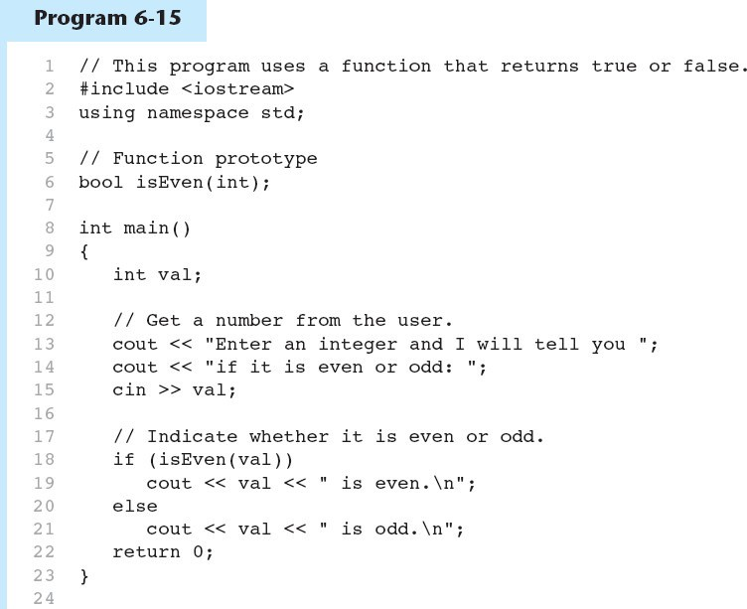
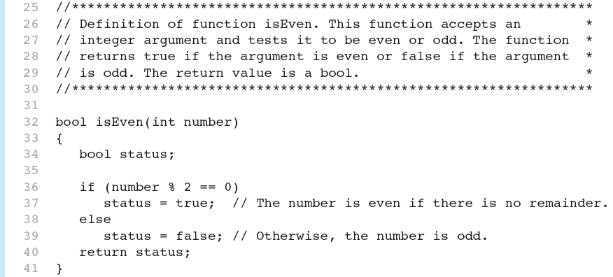

Returning a Boolean Value in Program 6-15
(Program Continues)

Slide 56
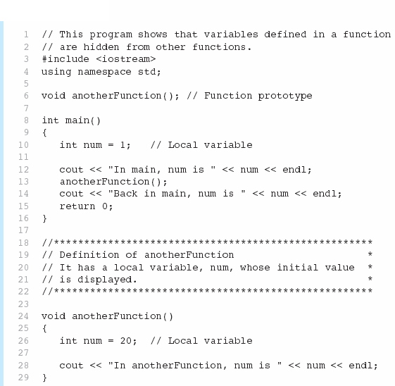

Local and Global Variables Local Variables in Program 6-16

Slide 57

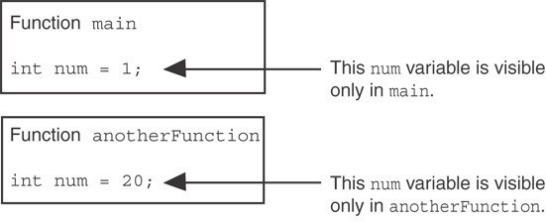
Local Variables in Program 6-16

Slide 58
Static Local Variables
static local variables retain their contents between function calls.
static local variables are defined and initialized only the first time the function is executed. 0 is the default initialization value.

Slide 59

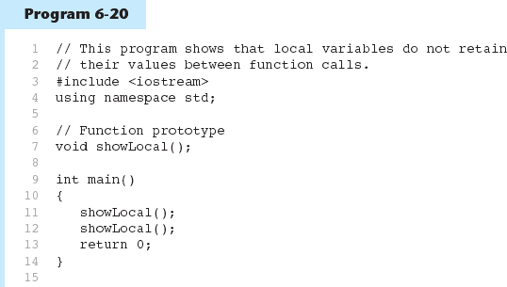
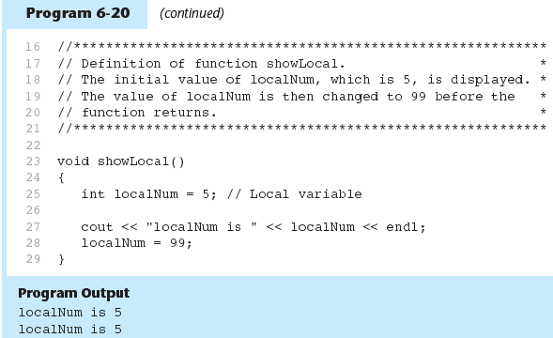
Local Variables Do Not Retain Values Between Function ca ls in Program 6-21

Slide 60
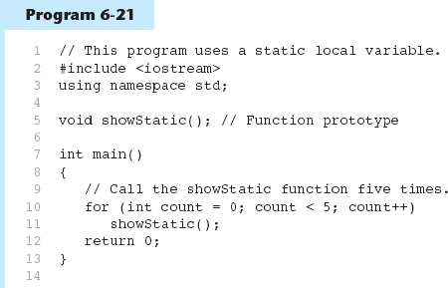

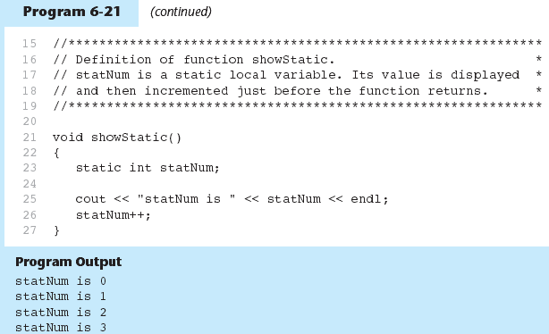
A Different Approach, Using a Static Variable in Program 6-22
statNum is automatically initialized to
0. Notice that it retains its value between function calls.
(Program Continues)
61

Slide 61
Must be a constant declared in prototype:
Default Arguments
void evenOrOdd(int = 0);
Can be declared in header if no prototype
Multi-parameter functions may have default arguments for some or all of them:
int getSum(int, int=0, int=0);

Slide 62
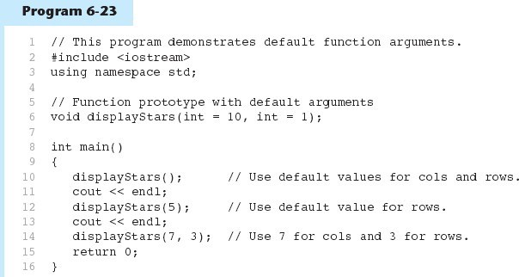

Default Arguments in Program 6-24
Default arguments specified in the prototype
(Program Continues)

Slide 63
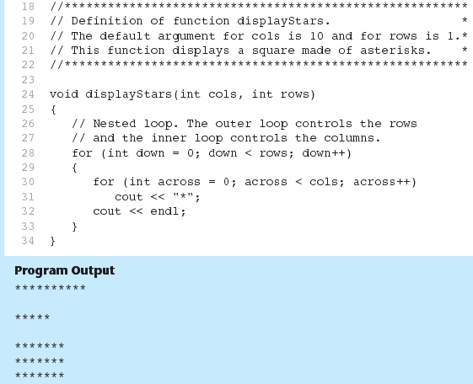
Default Arguments in Program 6-24

Slide 64
Default Arguments
If not all parameters to a function have default values, the defaultless ones are declared first in the parameter list:
int getSum(int, int=0, int=0);// OK
int getSum(int, int=0, int); // NO
When an argument is omitted from a function call, all arguments after it must also be omitted:
sum = getSum(num1, num2); sum = getSum(num1, , num3);
// OK
// NO

Slide 65
Using Reference Variables as Parameters
Allows the function to modify values stored in the calling environment
Provides a way for the function to ‘return’ more than one value

Slide 66
Passing by Reference
Defined with an ampersand (&)
void getDimensions(int&, int&);
Changes to a reference variable are made to the variable it refers to
Use reference variables to implement passing parameters by reference
void doubleNum(int &);

Slide 67
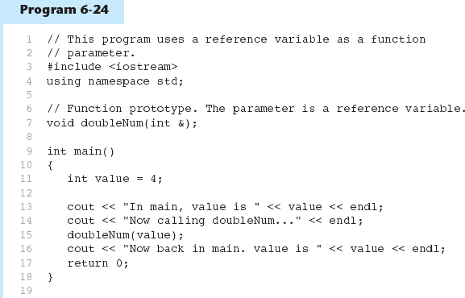

Passing a Variable By Reference in Program 6-25
The & here in the prototype indicates that the parameter is a reference variable.
Here we are passing value by reference.
(Program Continues)

Slide 68
Passing a Variable By Reference in Program 6-25
The & also appears here in the function header.

Slide 69
Function Overloading Examples
Using these overloaded functions,
void | getDimensions(int); // | 1
void | getDimensions(int, int); // | 2
void | getDimensions(int, double); // | 3
void | getDimensions(double, double);// | 4
the compiler will use them as follows:
int length, width;
double base, height;
getDimensions(length); |  | // | 1
getDimensions(length, | width); | // | 2
getDimensions(length, | height); | // | 3
getDimensions(height, | base); | // | 4

Slide 70



Function Overloading in Program 6-27
The overloaded functions have different parameter lists
Passing a double
Passing an int

